Slide 1
ROMAN NUMERALS
The kata!

Slide 2

Roman Numeral origins
Date back to Ancient Rome (8th century BC)
Used frequently up until late middle ages (1000 - 1250 AD)
Still used in BBC show credits and on clocks
Used Latin alphabet characters for numerical notation
I, V, X, L, C, D, M
Was the most used number system in Europe for over M years!

Slide 3
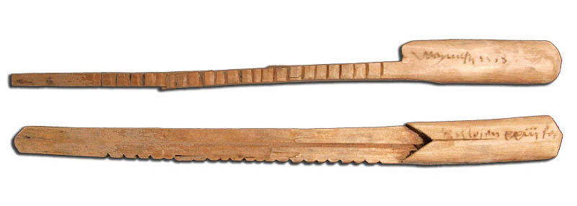
Why I V X L C D M?
I has roots in tally sticks (where the notch represents 1), or from the Etruscan tally counting system:
IIIII IIII = 9 … IIIII IIIII = 10… but this is a base 10 system so...
X = 10
V is half of X (the top half!), making it 5.
L is half of C...
Why they used L, C, D and M is detailed here: https://www.youtube.com/watch?v=Ik4yloCszYo

Slide 4
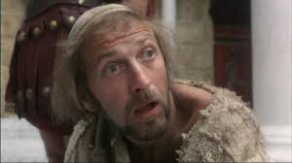
The good news: familiar base 10 system
i.e. when we get to 10, we create a new placeholder value to record 10.
Good for people with 10 fingers
Familiar to current Arabic number system we use today
But… only seven latin characters are used

Slide 5
The bad news (I): repetition of characters
Rather than have one character per number, they are often repeated.
1 = I
2 = II
3 = III

Slide 6
The bad news (II): irregular subtractive notation
1 | I
2 | II
3 | III
4 | IV | one from five
5 | V
6 | VI | five and one
7 | VII
8 | VIII
9 | IX | one from 10
10 | X

Slide 7
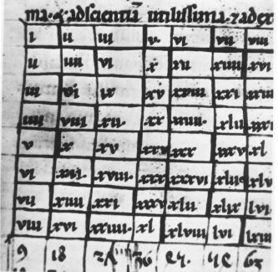
Problems
Numeral length is no indicator of scale
XXXVIII (38) might looks bigger than DLX (560)
No zero
Because there is no 0, it is harder to
do arithmetic with, but not impossible.

Slide 8

Our Challenge
Write a function to convert our current (Arabic) numbers (1,2,3,..) to their equivalent Roman Numerals.
Don’t worry about any numbers bigger than 3000...
...for a long time the Romans didn’t have a use for numbers over 1000!

Slide 9

Sometimes at the Code Dojo
Too many tasks to finish
I rush to try to get as much done as possible
Code quality suffers
Usually just one solution explored

Slide 10

So this time...
DRY?
clean your code?
find another algorithm?
(you’ll have tests!)
code reveals intent?
different language?
can your algorithm be presented in a different way?
well tested?
100% confidence?
Notes:
You (hopefully) have tests, so…
See if there’s a different algorithm you can implement… if you can’t think of one, let James know he can try his best to describe one for you to implement.
See if you can make your code easily reveal the underlying algorithm, if I glanced at it, would I get an intuition about how it works?
Is your code clean, well-written, understandable, without duplication?
Have you tested it thoroughly, do you think it is 100% correct?
Is there a language you have used that you feel would greatly excel at this problem, try converting your algorithm to a different language?
Can your algorithm be presented in a different way:
· Recursion / Corecursive
· Loop
· Folds
· Functional or Imperative
· Other language features you could use?
^ How does this change the readability of the code?

